Slide 1

HR ANALYTICS EMPLOYEE ATTRITION
- PRESENTED BY MOHAMMED UMAER

Slide 2
PROJECT DESCRIPTION
This project relates to an attrition problem of a company, where we need to find the most important factors which affect attrition.
To solve this problem I have done Exploratory Data Analysis on the given data set using Python.
The EDA includes a detailed description of Data, Variable Description, Univariate, Bivariate, and Multivariate Insights.

Slide 3
ABOUT THE DATA-SET
The data set has 20 variables such as Age, Gender, Attrition, Department, Monthly Income, Over time, etc…
We have a total of 1470 employees’ information with 35 features that shows the information corresponding to each employee. The Attrition column indicates the employee status showing that the employee stayed at the company or leave the company.
Our Target Variable for analysis is “Attrition”.
“Attrition” columns indicate “Yes” if the employee quit the job and “No” employee stayed at the company.

Slide 4
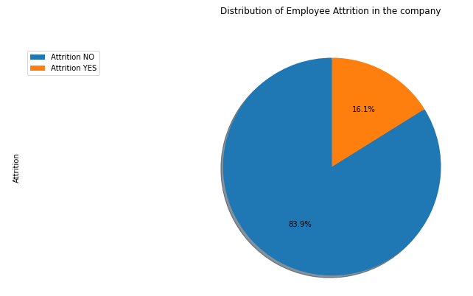
UNIVARIATE ANALYSIS
Attrition Rate
237 People have left the company
The attrition rate is 16.1%

Slide 5
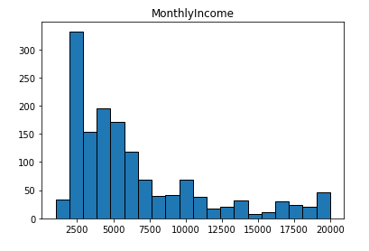
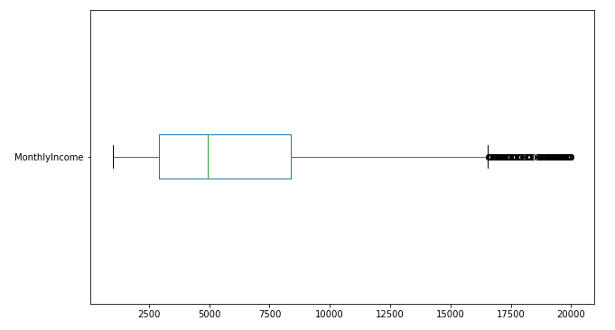
Monthly Income
The Monthly income data is right-skewed which tells us that the mean of the dataset is at the left meaning the less income group has more frequency than the higher income group.
The mean (6502.93) and median (4919) has a huge gap of a lump sum of 1500.
Most of the sample fall below the upper quartile

Slide 6
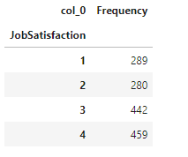
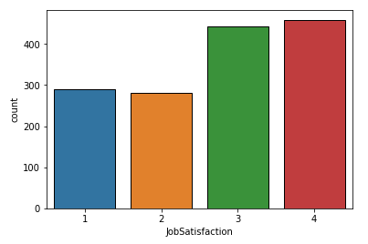
Job Satisfaction
Only 289 people are unsatisfied with the job and has rated 1 in Job Satisfaction

Slide 7
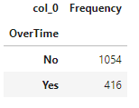
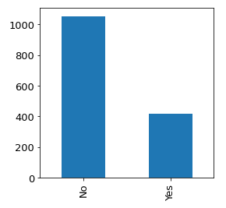
Over Time
More than a quarter which is 28.29% of the people works overtime which is a huge number.

Slide 8
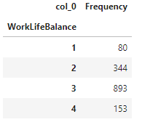
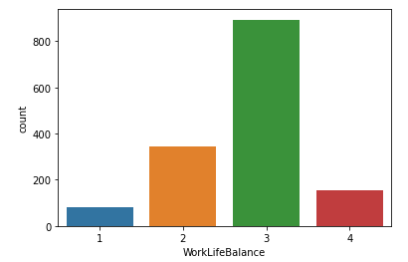
Work-Life Balance
Only 80 samples have given ratings as 1 and the maximum has given 3 as a rating.

Slide 9
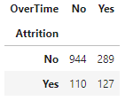
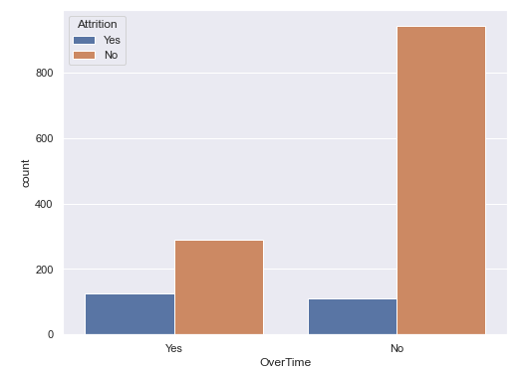
BIVARIATE ANALYSIS
Over time & Attrition
People doing overtime has a 30.53% probability of leaving the company as compared to the people who are not doing overtime and still are prone to leave the company with a 10.44% probability
Notes:
Employees working over time are likely to leave the company

Slide 10
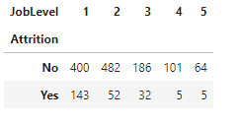
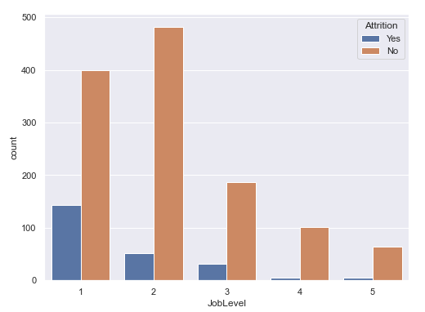
Job Level & Attrition
People who are involved in Job Level 1 have the highest probability of leaving the job followed by Level 3.
Notes:
Employees who are at lower job level are more prone to leave the company

Slide 11
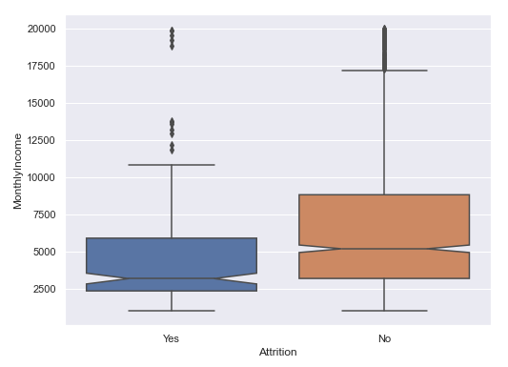
Monthly Income & Attrition
We can see in the plot that the frequency of people leaving the company is more in between 1000 to 2500.
Notes:
Employees who are at lower job level are more prone to leave the company

Slide 12
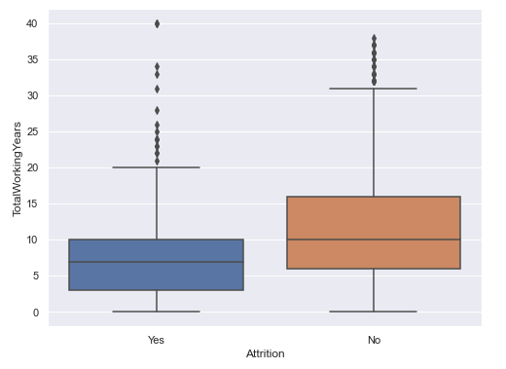
Total Working Years & Attrition
We can notice in the plot that People with experience in the range of 0-2 years are more prone to quit, but we can see people with either 5 or 10 years of experience quitting as well.
.
Notes:
Employees who are at lower job level are more prone to leave the company

Slide 13
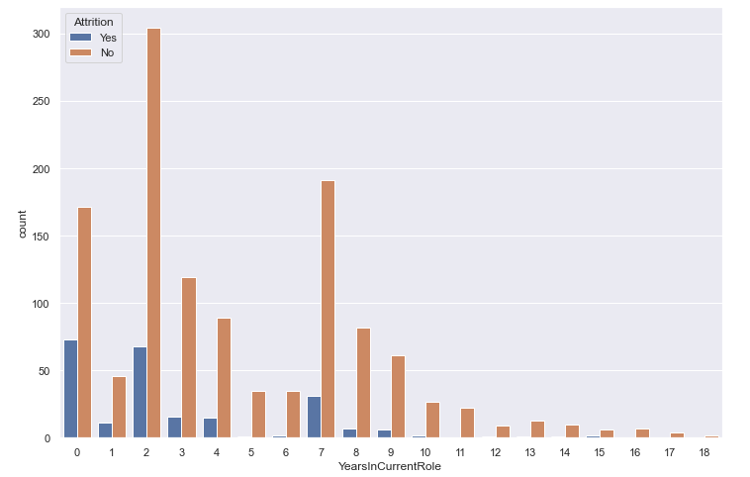
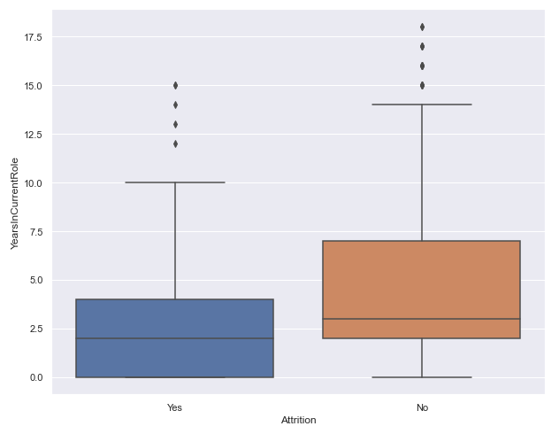
Years in Current Role & Attrition
People with even 0 years in their current role (maybe they have shifted from another role to a new role) account for 74 in the total count and have left the company.
There are only 4-5 people who have left the company after spending around 12 -15 years in the current role.
Notes:
Employees who are at lower job level are more prone to leave the company

Slide 14
MULTIVARIATE ANALYSIS
Job Satisfaction, Monthly Income & Attrition

Slide 15
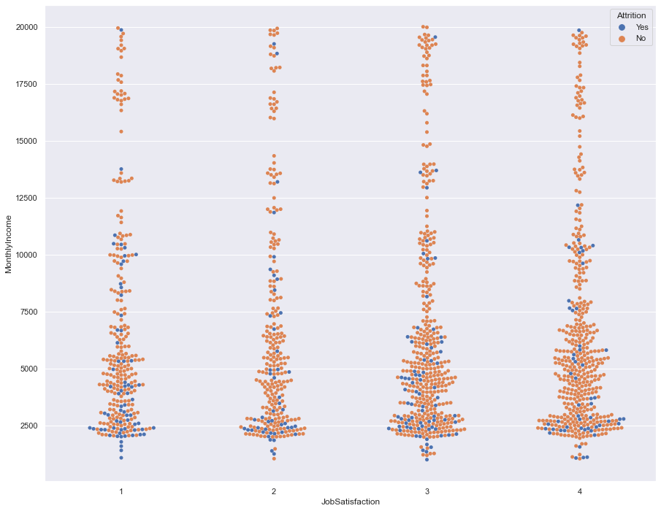
Employees with Lower monthly income & lowest Job Satisfaction are more prone to leave the Company but Employees with a lower Monthly Income but a Satisfaction level as good as 3, are also leaving the company at higher rates. In a few exceptional cases, Employees with the highest salary and with the lowest to highest Job Satisfaction are also leaving the Company.

Slide 16
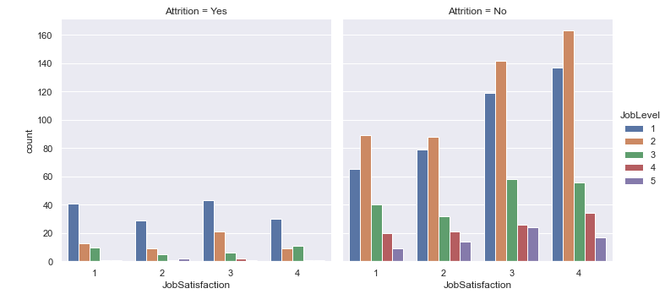
Job Satisfaction, Job Level & Attrition
We can clearly see that attrition is more in the case of Employees at Lower Job levels at any level of Job Satisfaction.

Slide 17
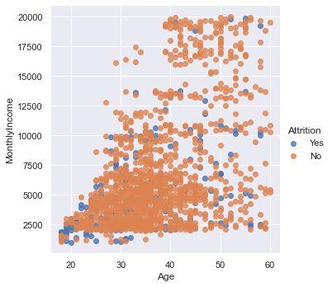
Age, Monthly Income & Attrition
The highest number of Attrition is seen among Employees of the age-group 20-35 with a Monthly Income of Rs.10000.

Slide 18
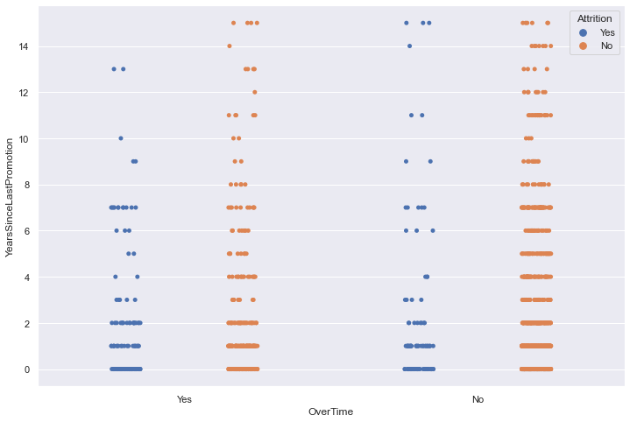
Over Time, Years Since Last Promotion, & Attrition
Most Employees with around 0-3 years since promotion are leaving the company irrespective of Overtime done or not.`

Slide 19

CONCLUSION
FACTORS AFFECTING MOST IN ATTRITION ARE:
Overtime
Job Level
Monthly Income
Total Working Years
Years in Current Role

